Slide 1
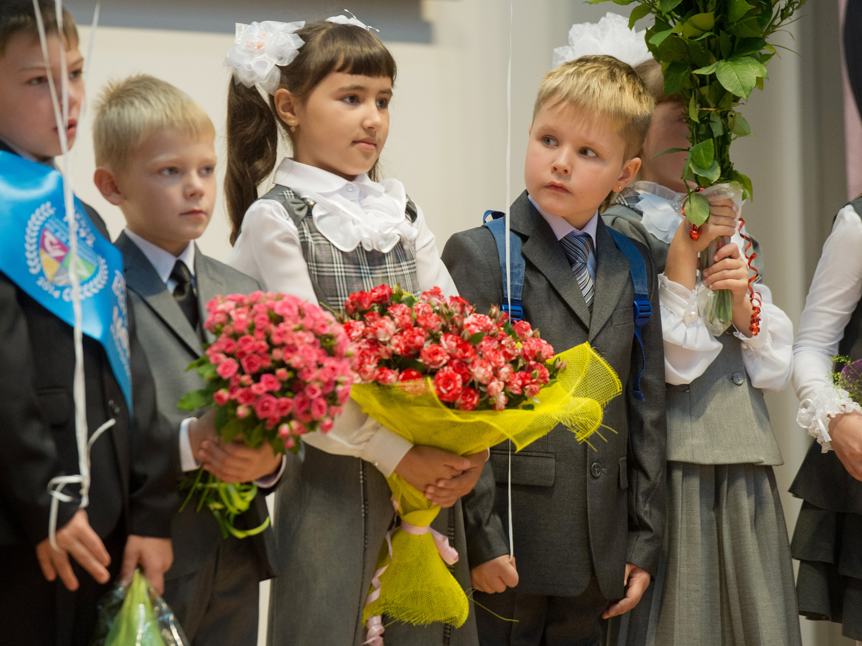
art in russian education
and selected pieces of Russian art

Slide 2
how do 🇷🇺 russian people study
Preliminary optional education — 2 to 6 years old
Mandatory school education — 6-7 to 13-14 y.o.
Completed school education — 13-14 to 16-17 y.o.
or College, 2-4 years
👲
University — from 17 to 21-24 y.o. typically

Slide 3
What about arts?

Slide 4
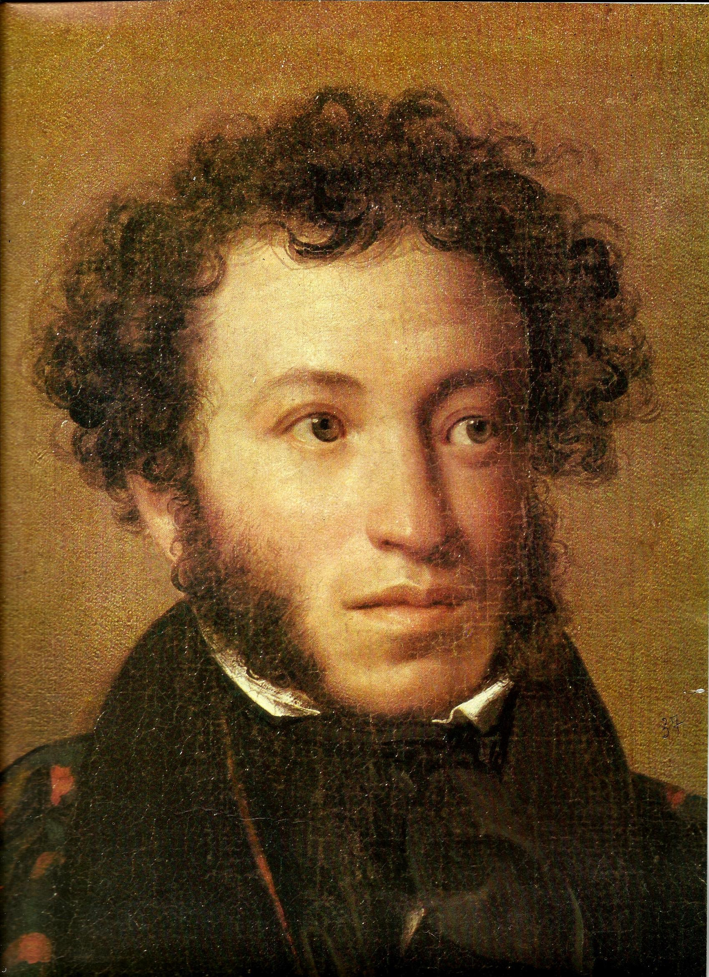
russian
literature and poetry
is the most important art subset that
is taught through over all years of study

Slide 5
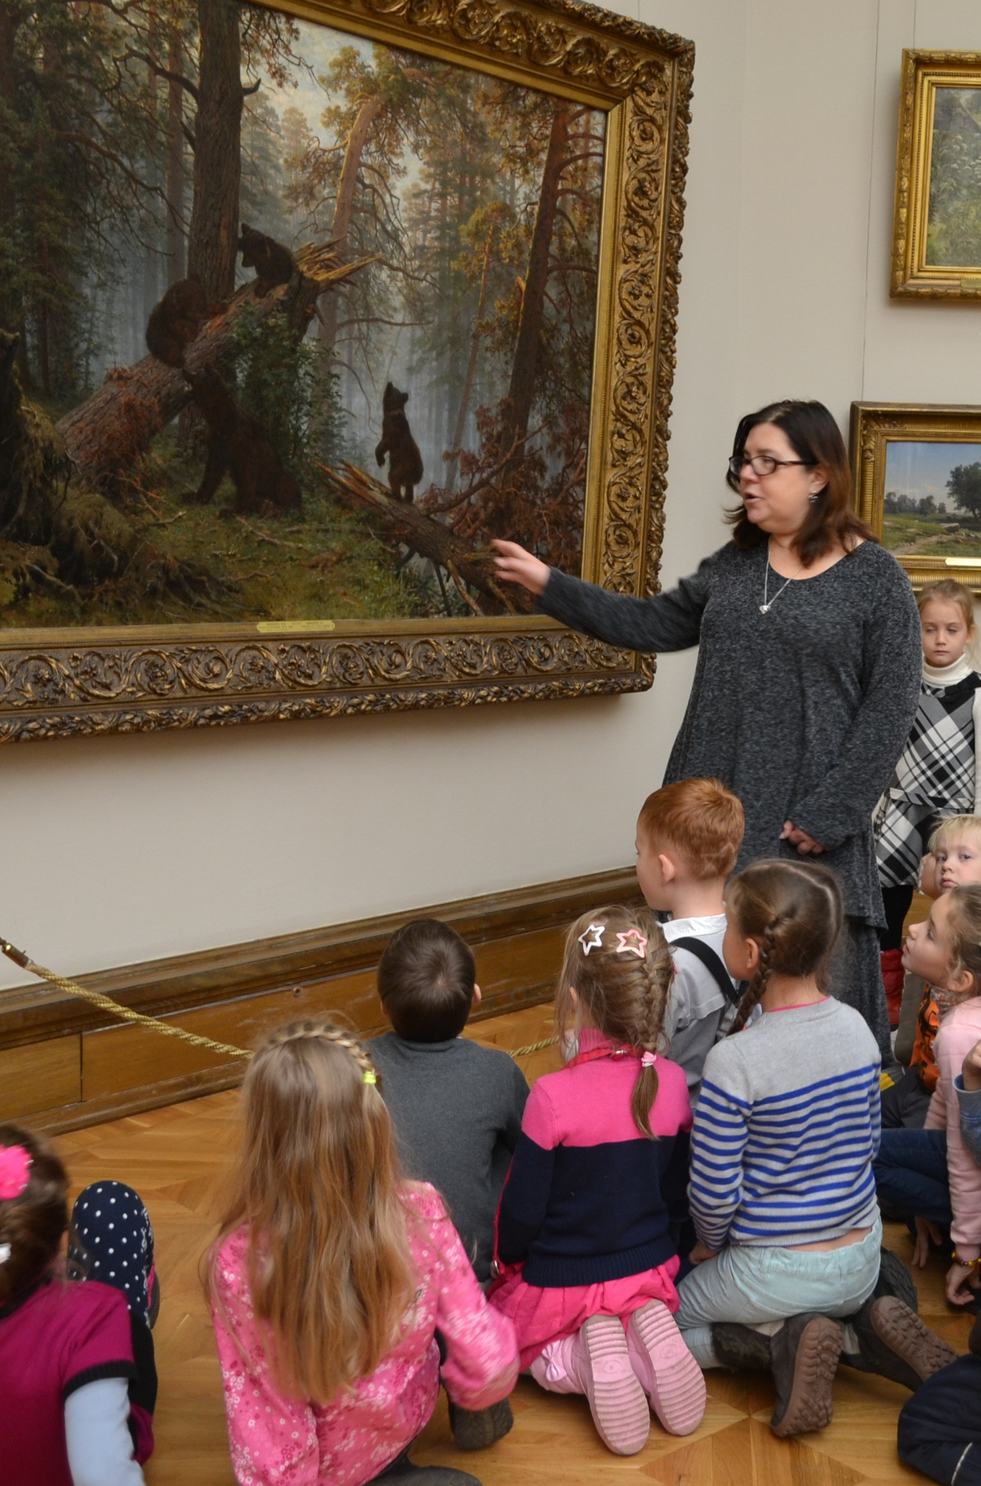
painting
painting lessons in grades 1-7
tours to famous Russian art galleries
optional painting classes outside of the school

Slide 6
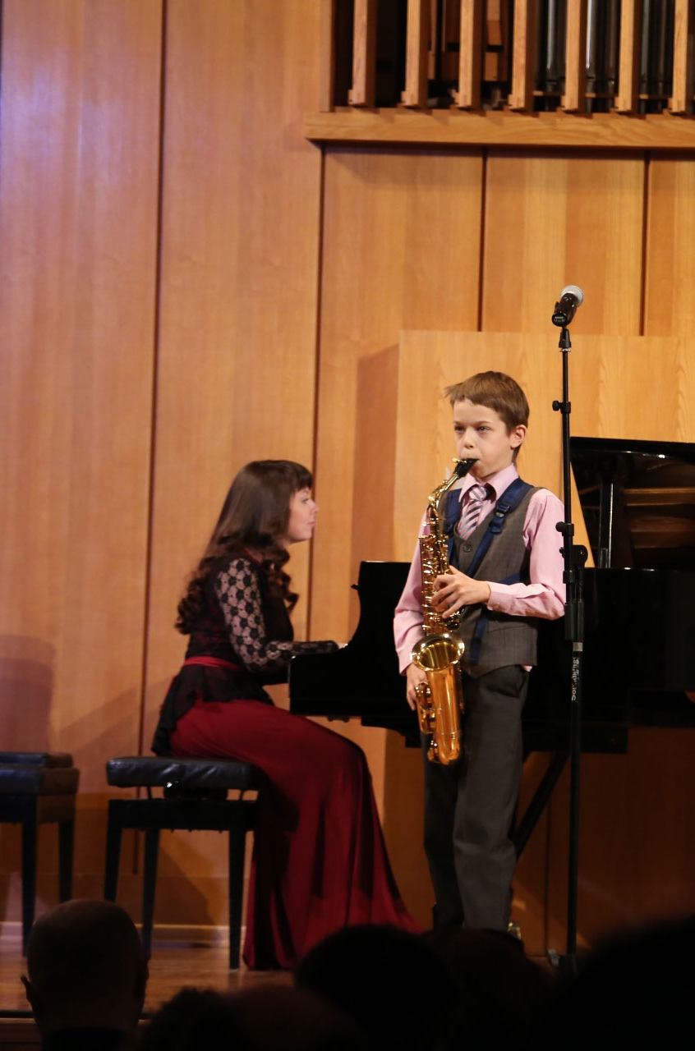
music
music lessons in some ordinary schools in grades 1-9
optional special music schools

Slide 7
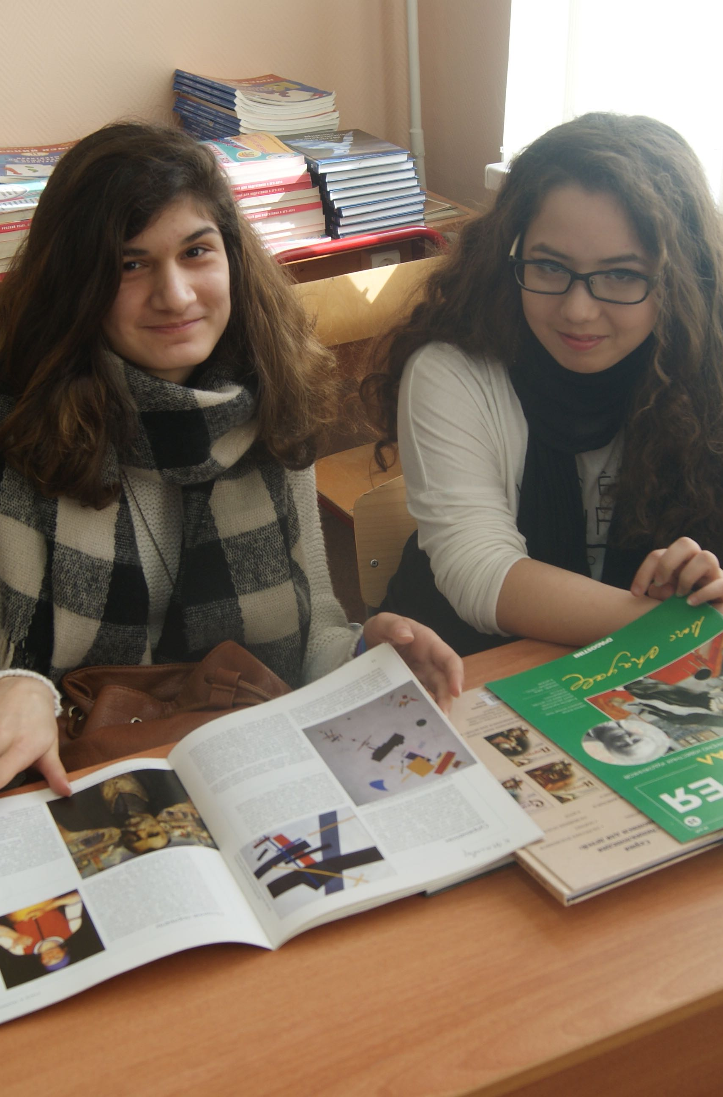
world fine arts
in schools (grades 7-11)
in colleges and universities

Slide 8
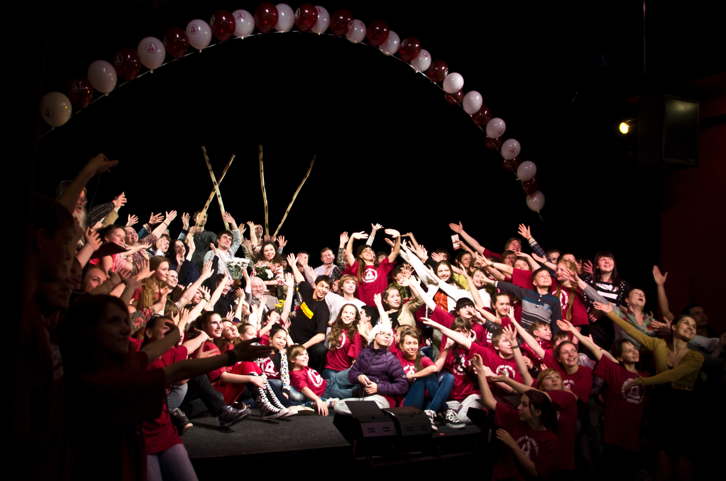
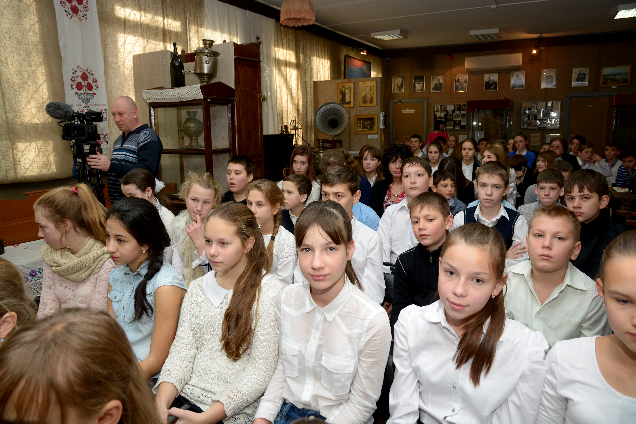
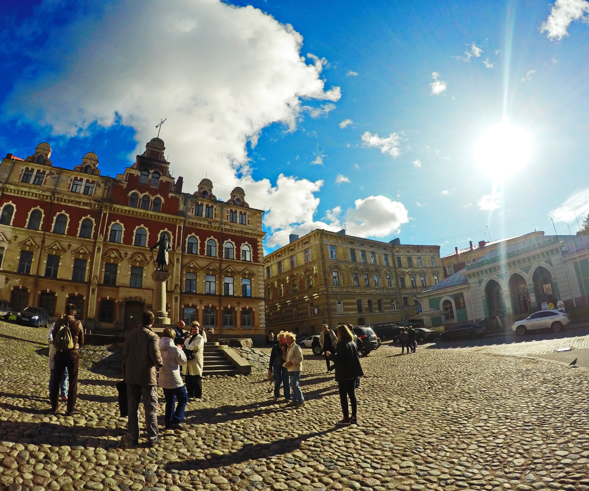
Russian teachers guide their students to museums, theaters, art galleries, show them architectural sights, and sometimes go abroad if their students’ parents can afford this.

Slide 9
how much do we spend?
I don’t know. But I’ve prepared something more interesting

Slide 10
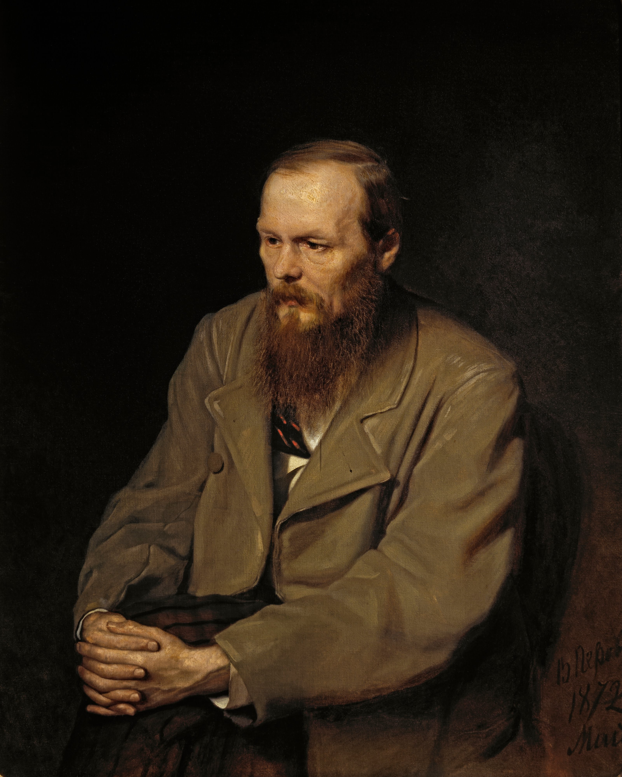
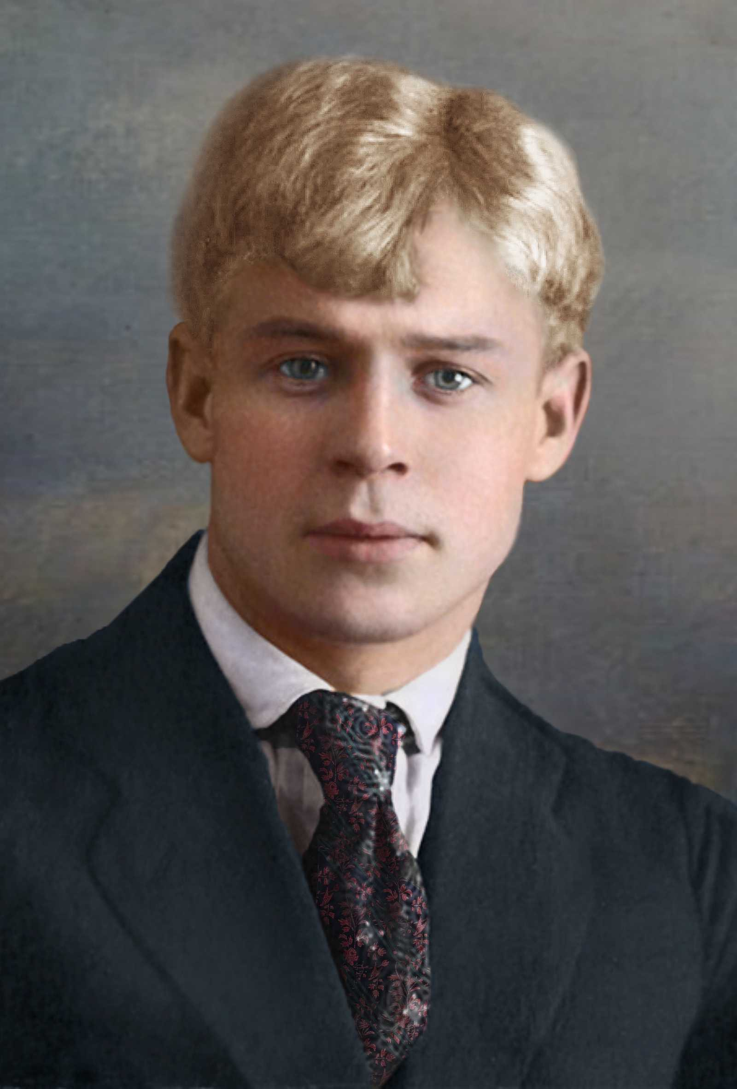
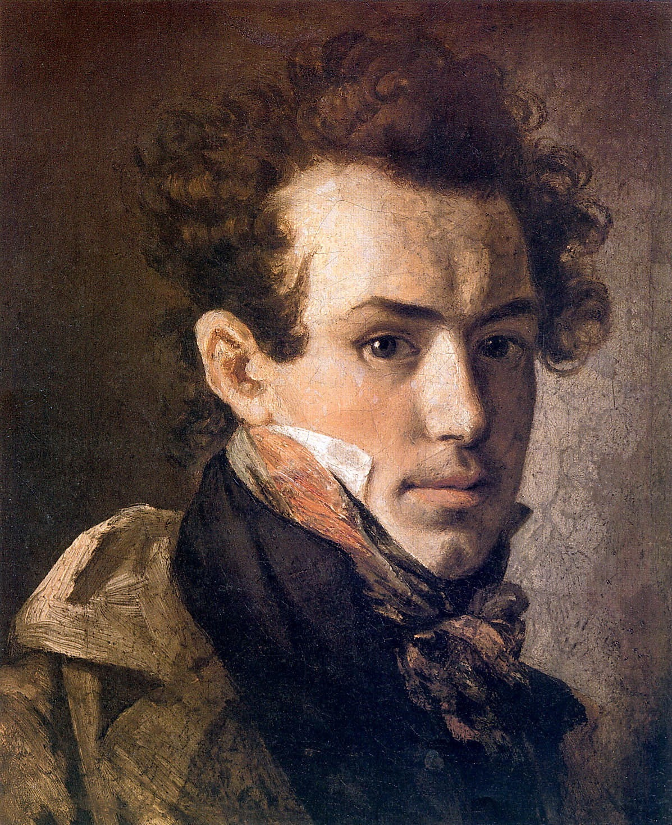
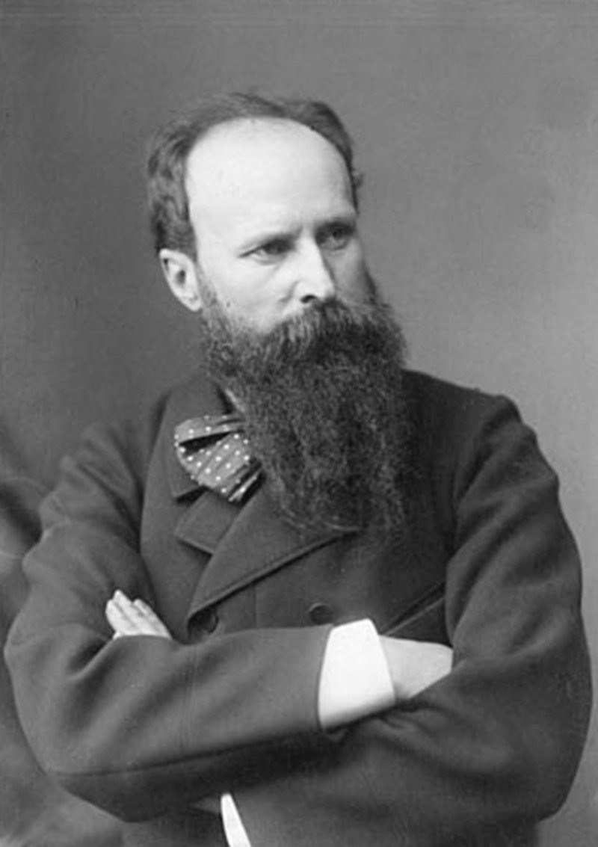
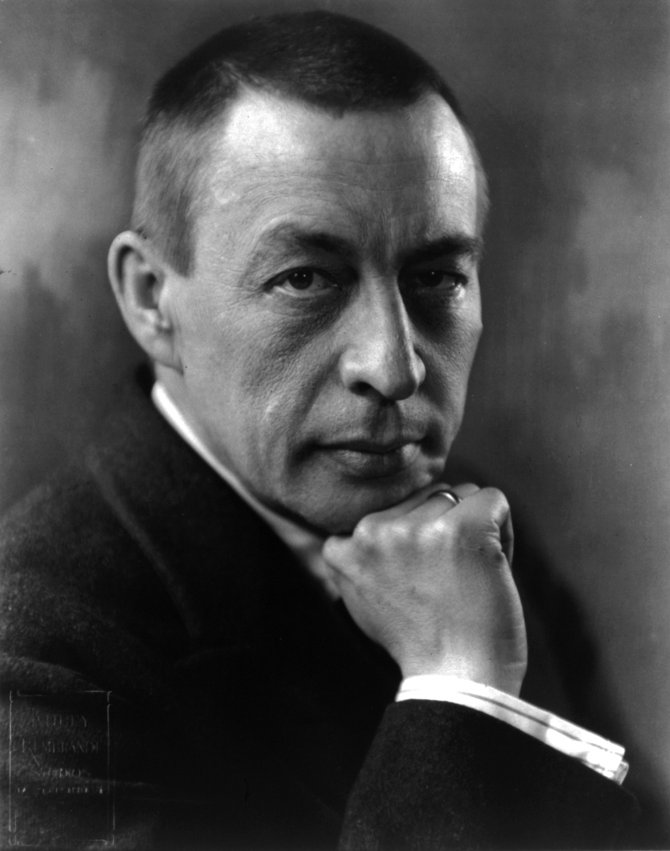
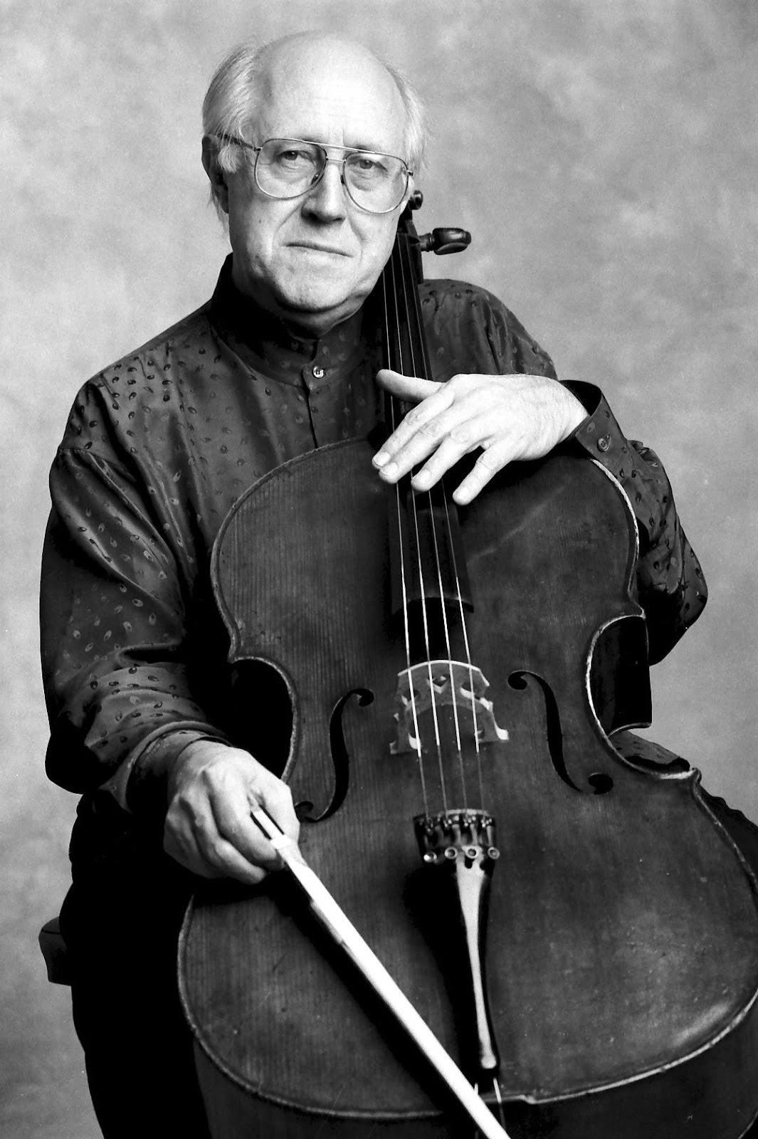
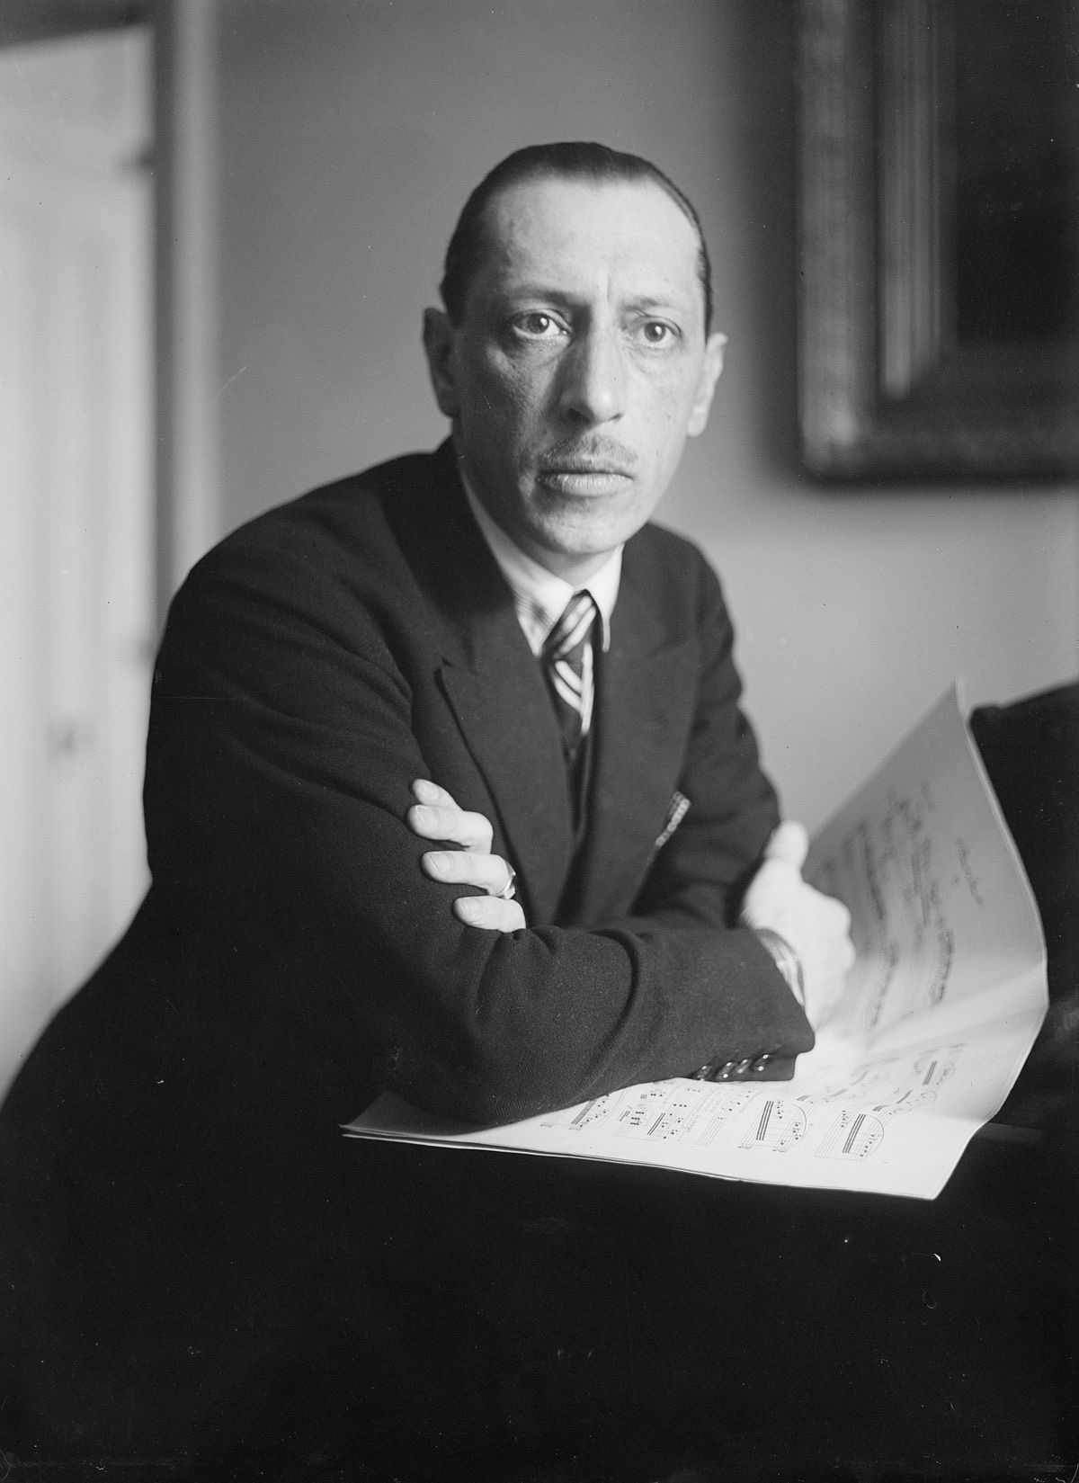
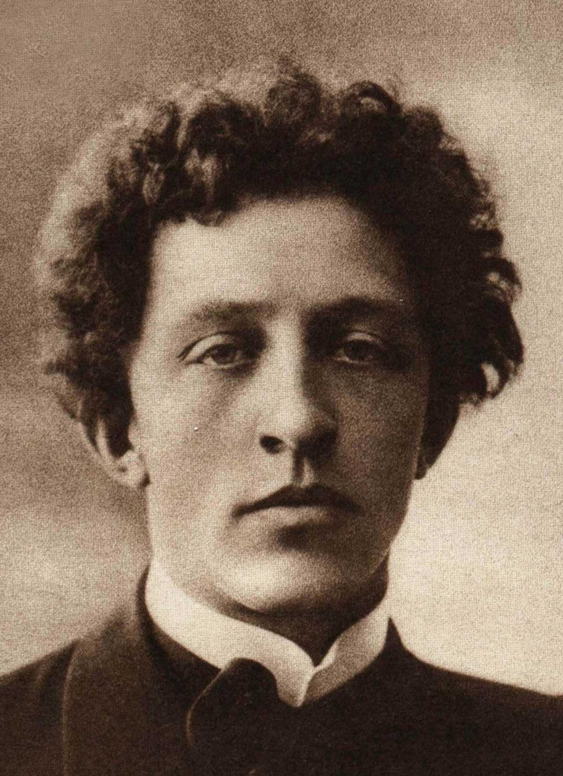
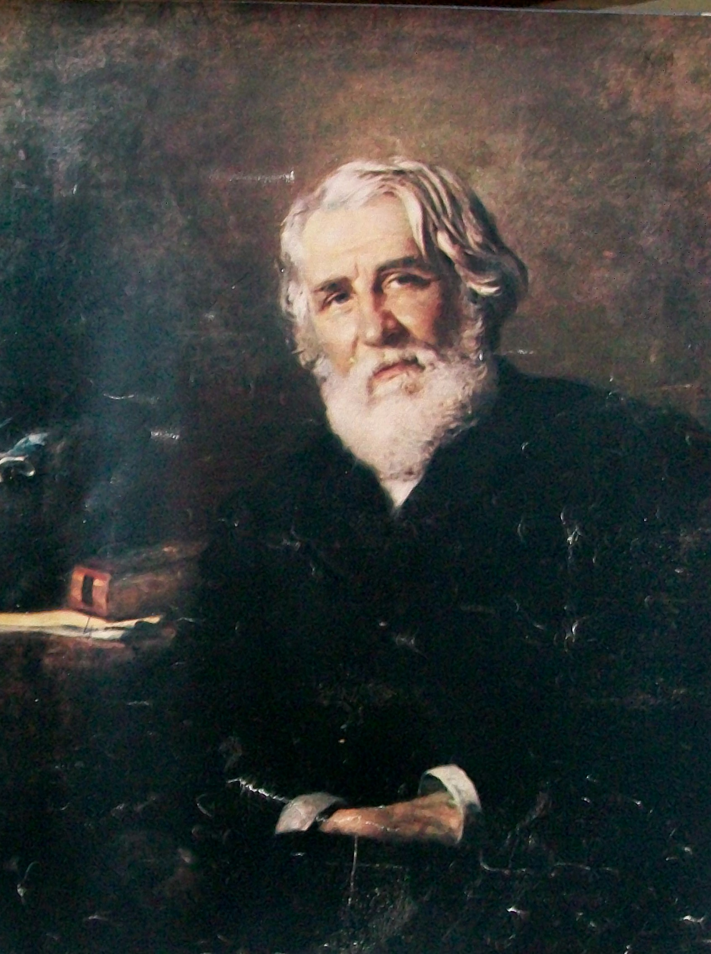
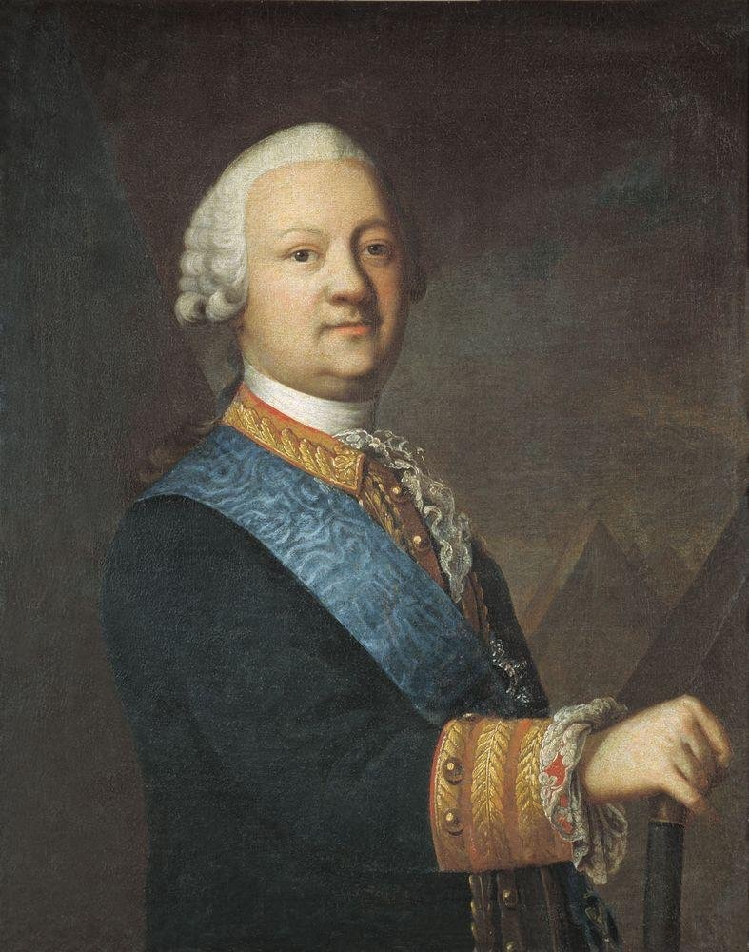
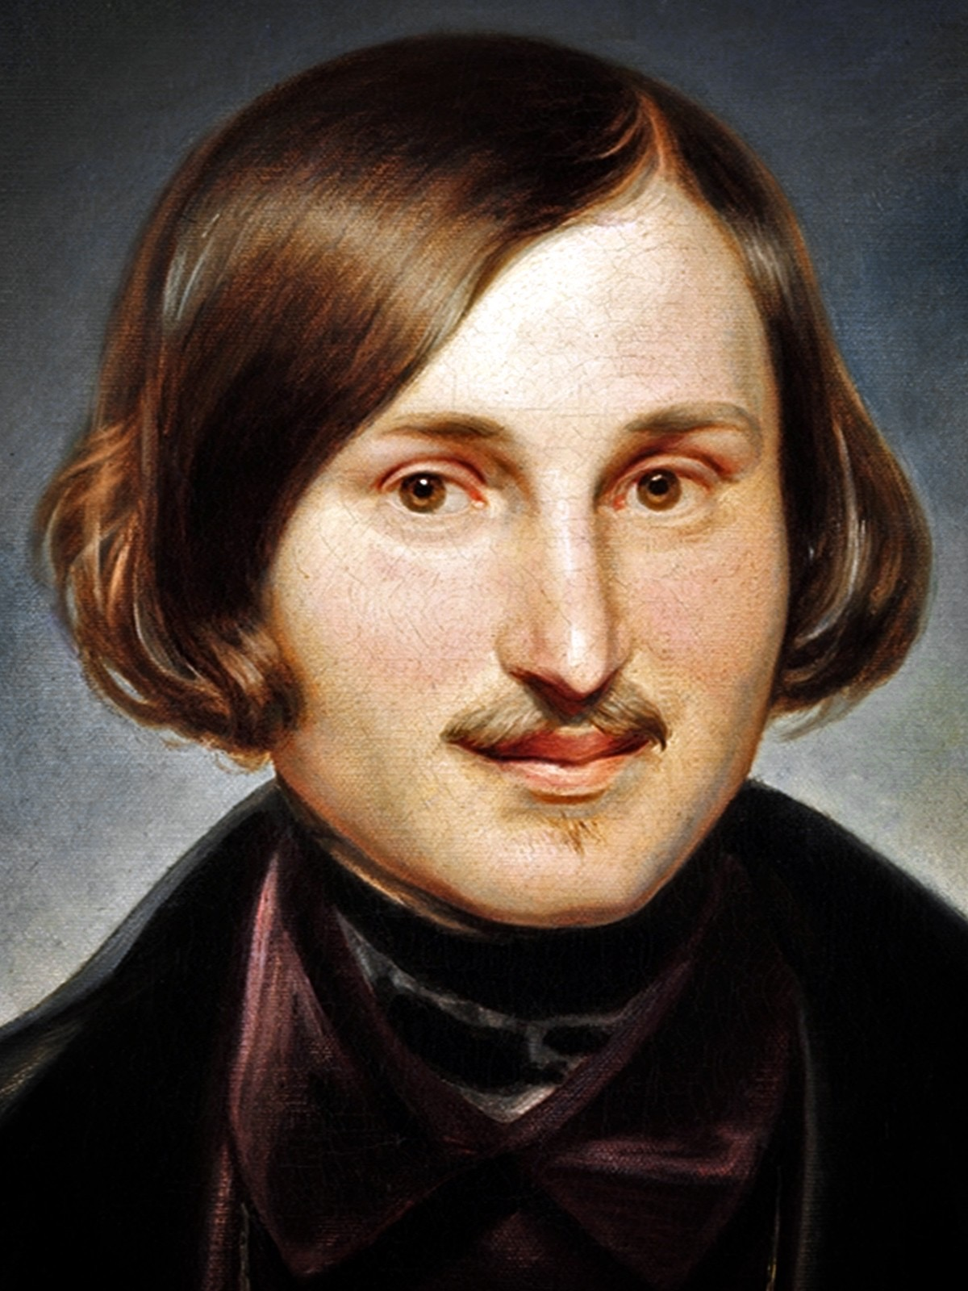
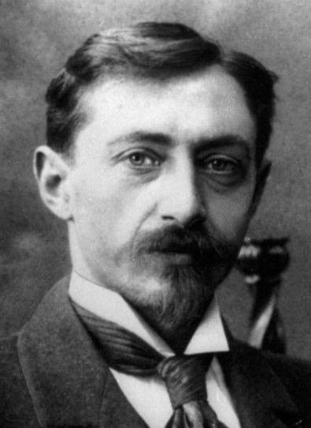
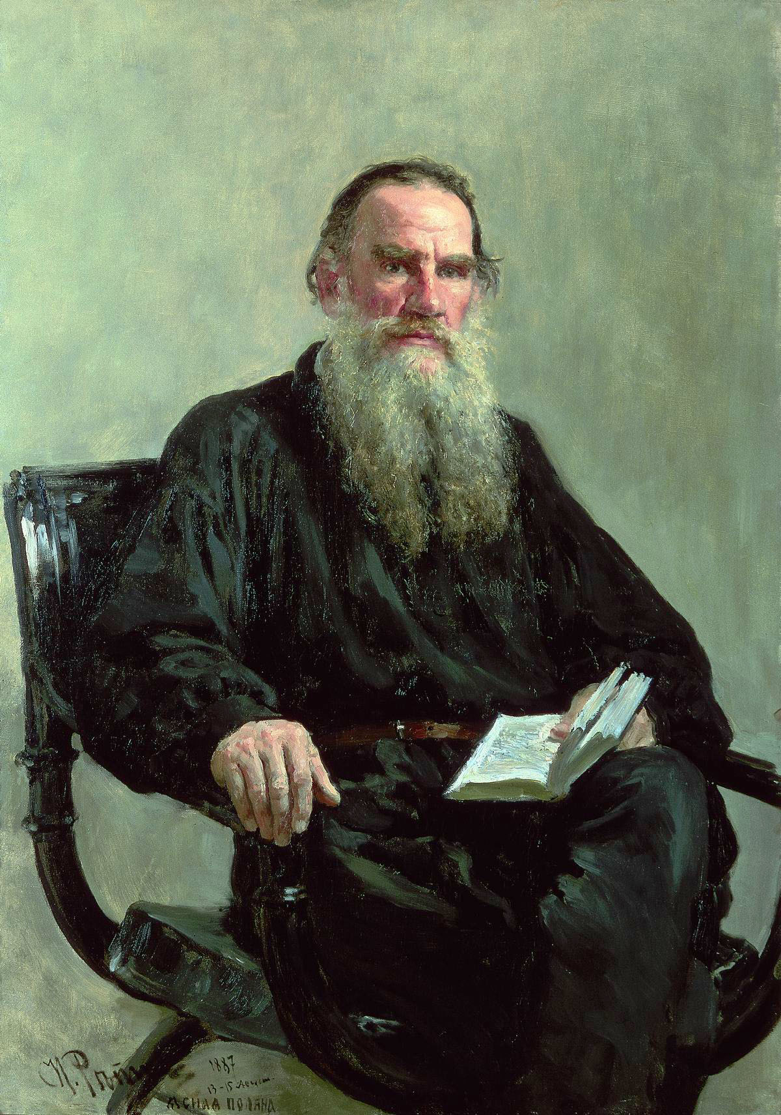
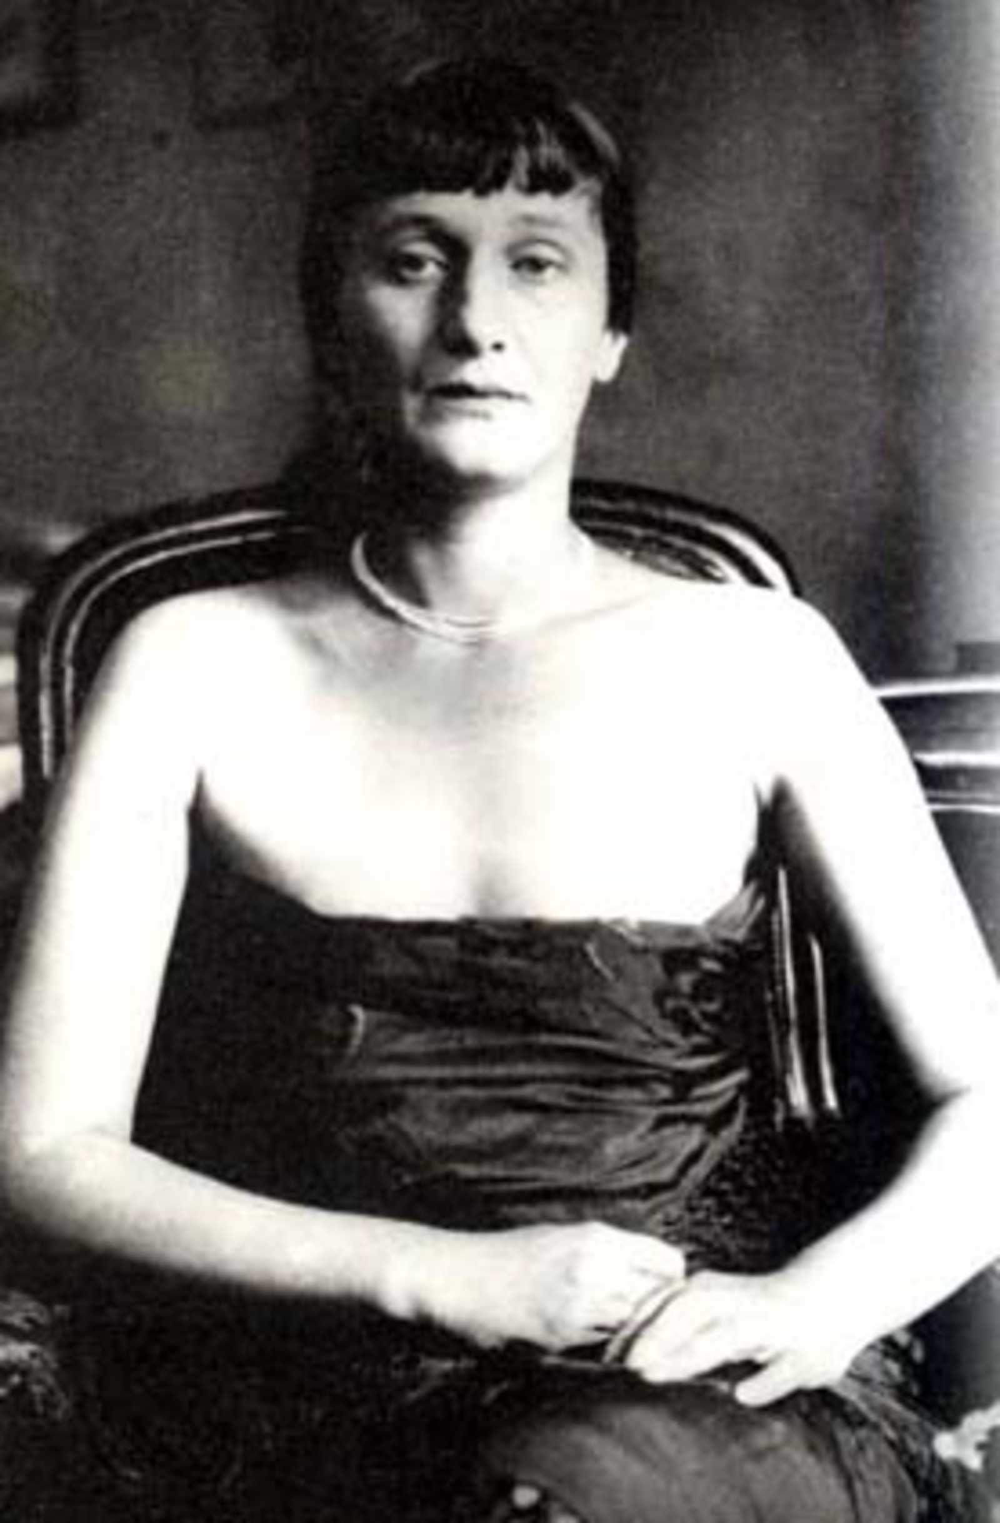
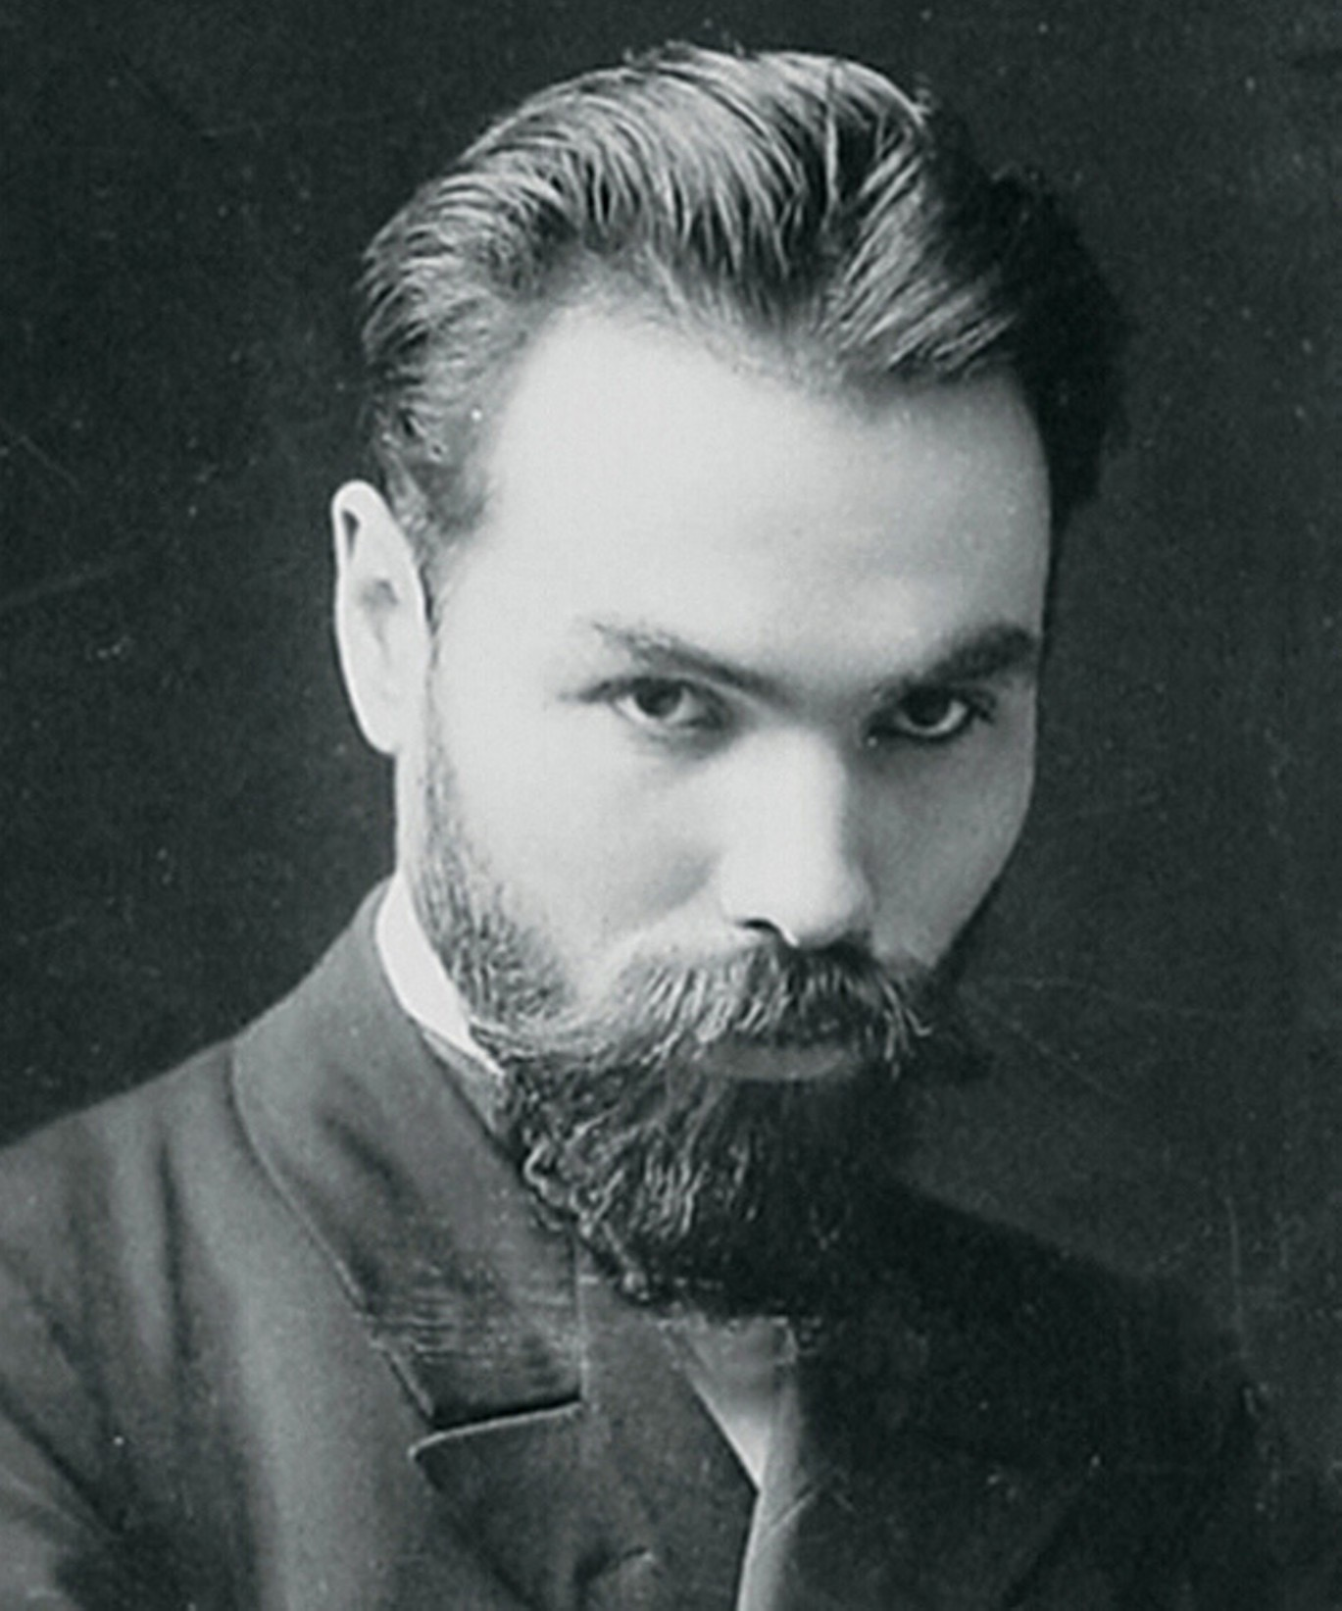
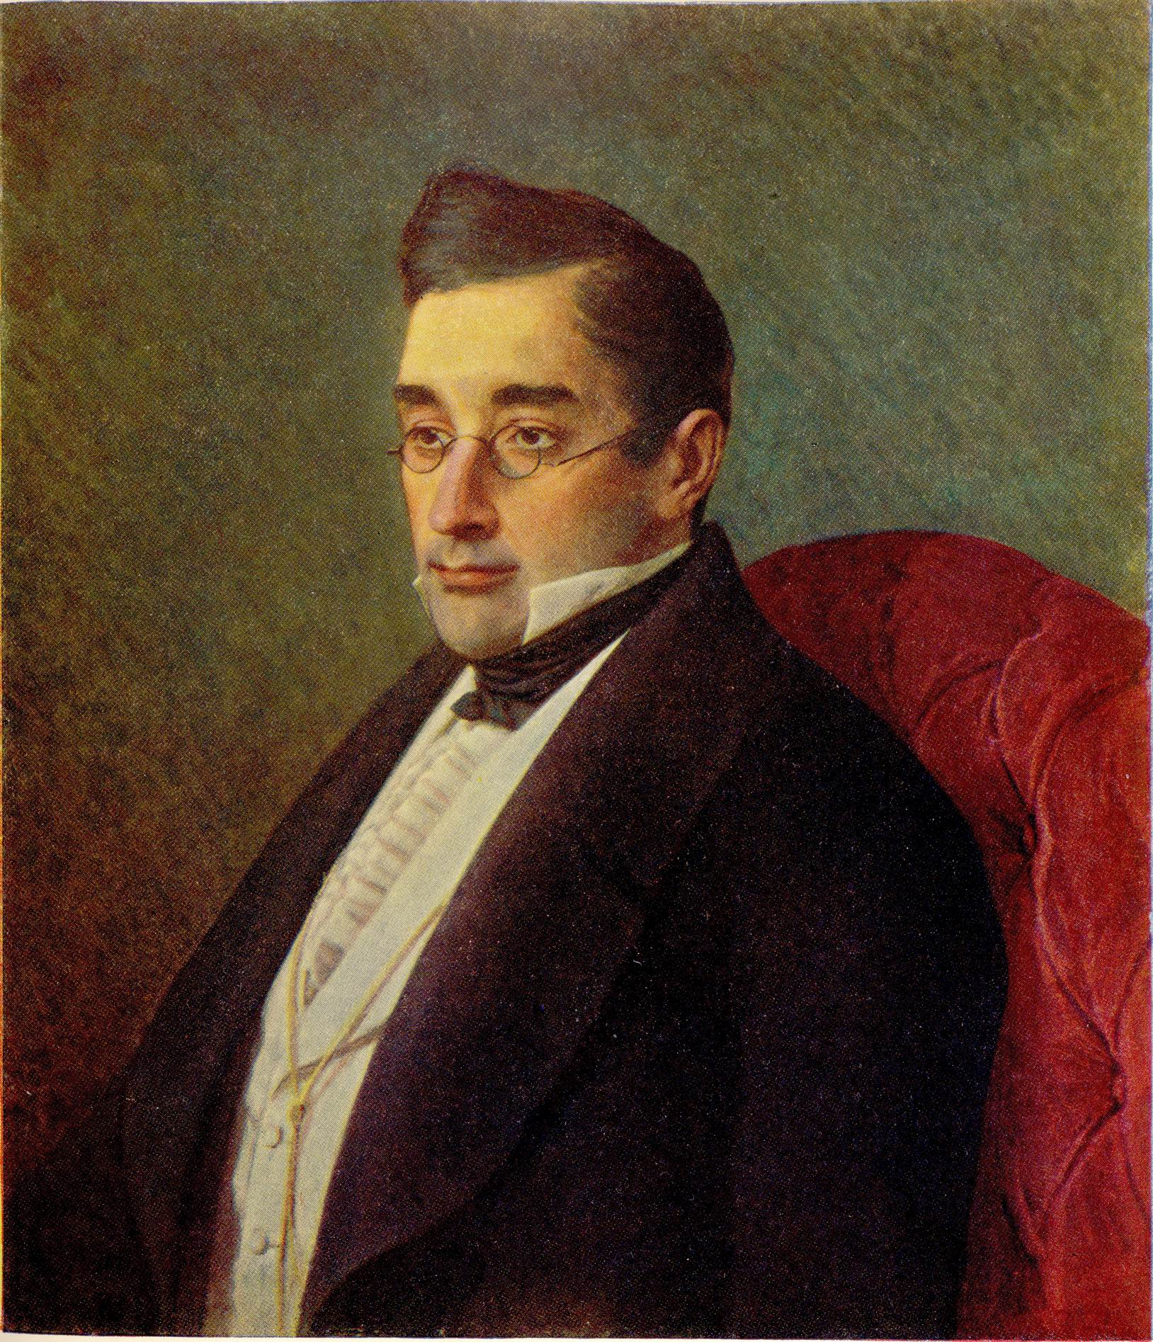
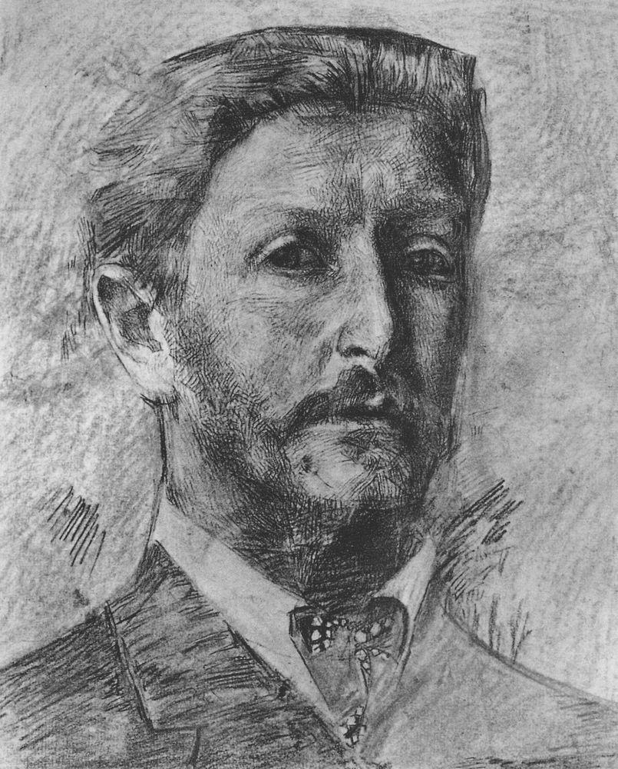
famous russian writers, poets, painters, composers...

Slide 11
there are way more of them than you’ve just seen

Slide 12
but i’ve chosen two.
both move me more than others

Slide 13
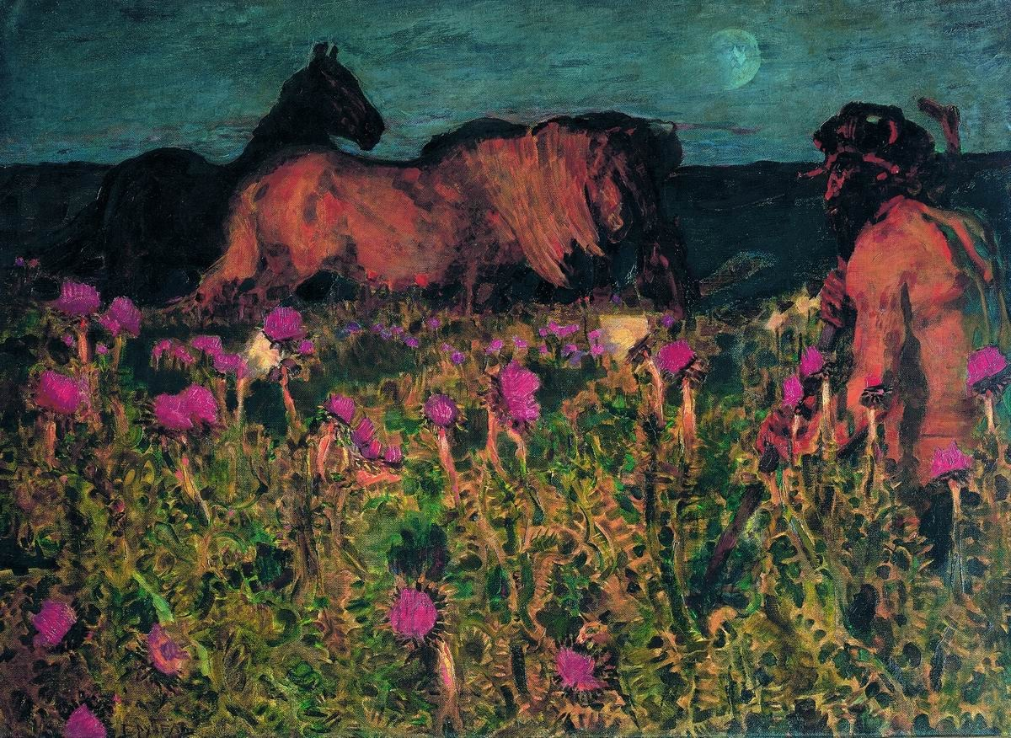
To Night, 1900

Slide 14
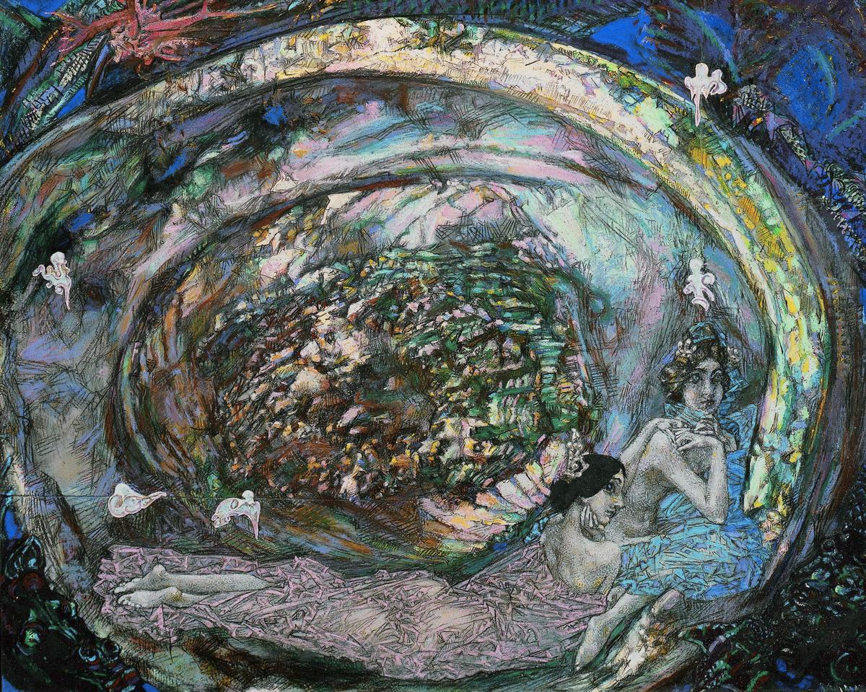
Pearl, 1904

Slide 15
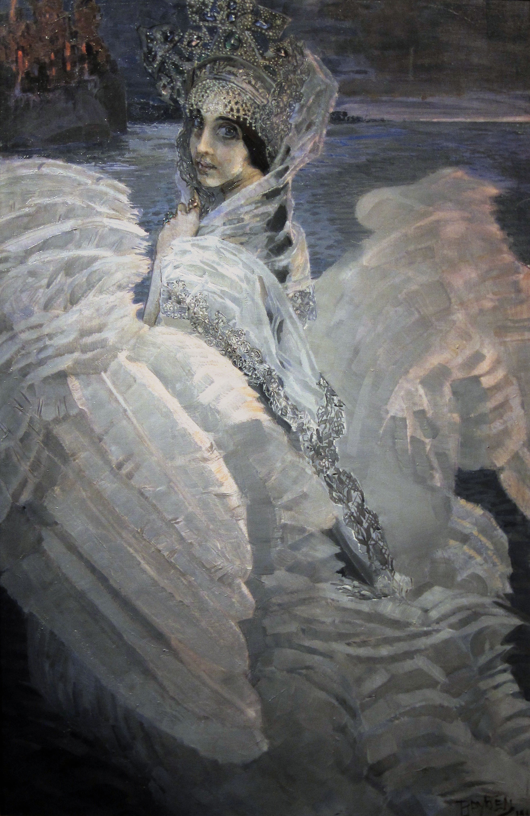
Tsarevna Swan, 1900

Slide 16
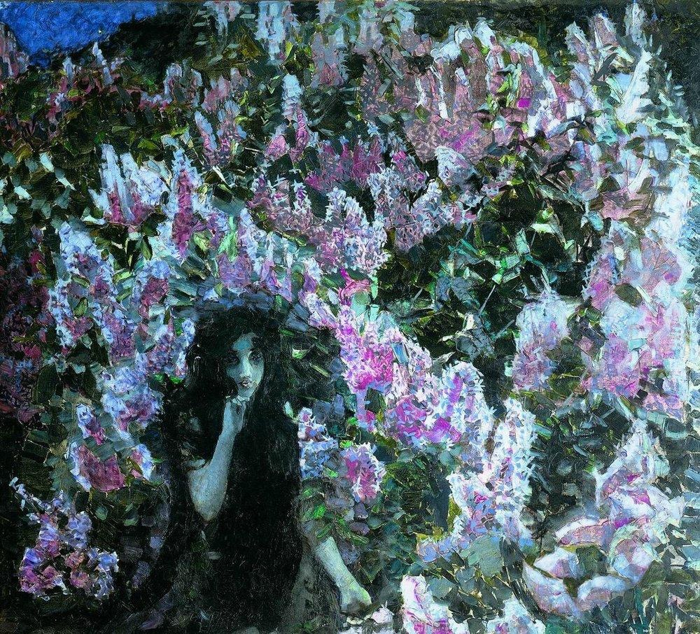
Lilac, 1900

Slide 17
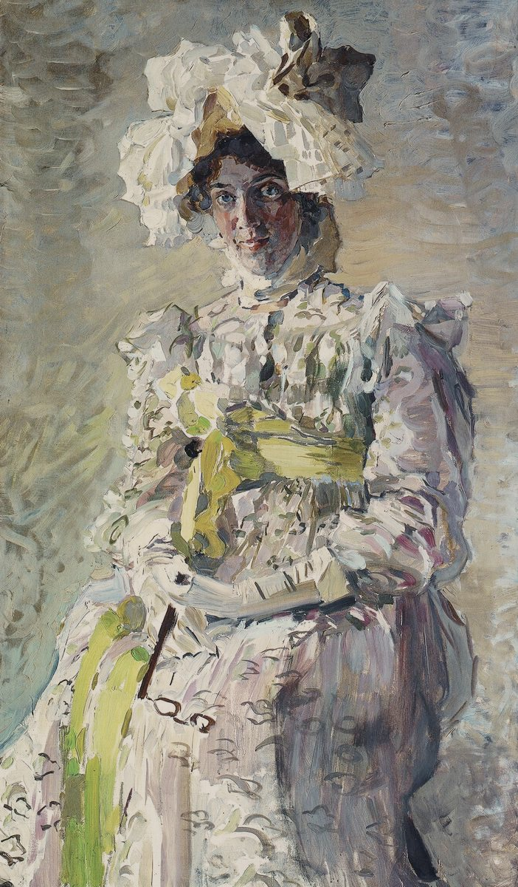
Portrait of the Wife

Slide 18
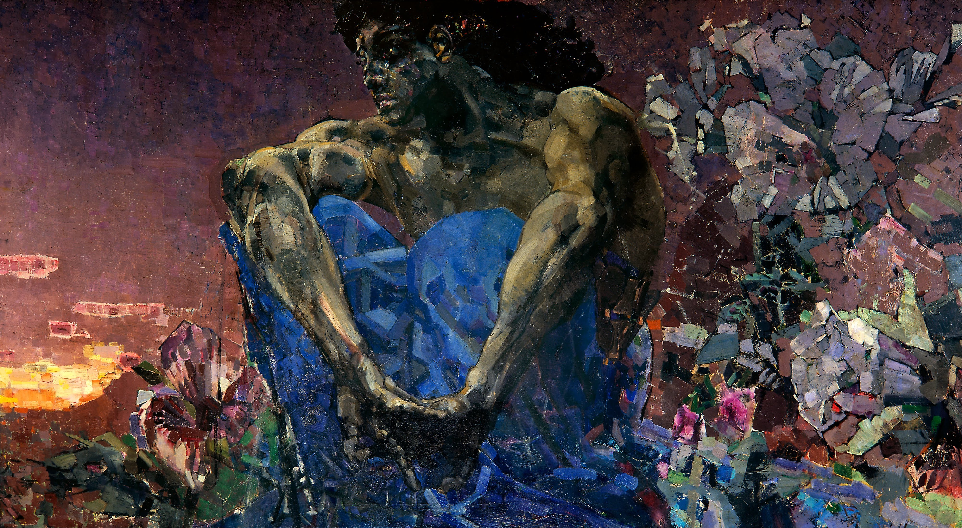
Sitting Demon, 1890

Slide 19
mikhail
vrubel
Sergei
rachmaninoff
paintings
Etude-tableau Op.39 No.3 in F-sharp minor,
played by Vladimir Ashkenazy

Slide 20
thank you
Download these slides:
http://oleggromov.com/stuff/cwc-russian-art-2017-03.pdf

